Slide 1

Wellness Announcements

Slide 2
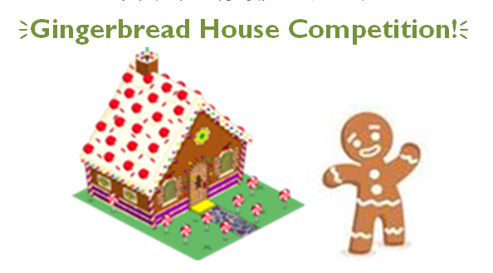
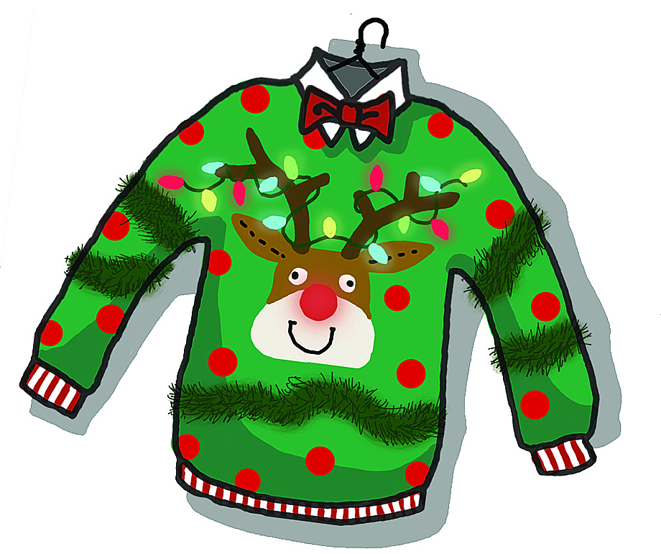

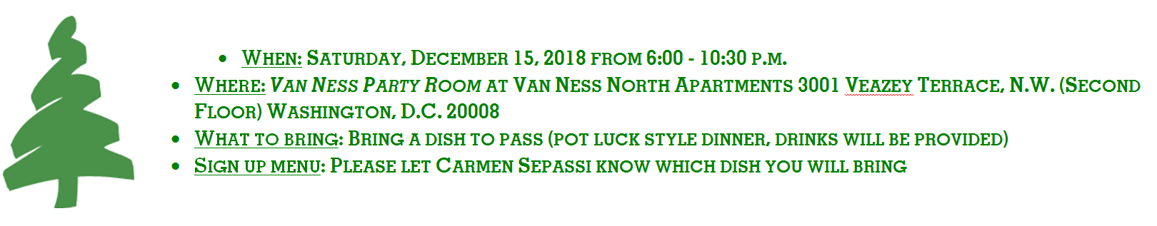
Partners’ Annual Holiday Festivities
Friday, December 14 (Danielle/Renata)
Saturday, December 15 (Carmen/Barbara)

Slide 3
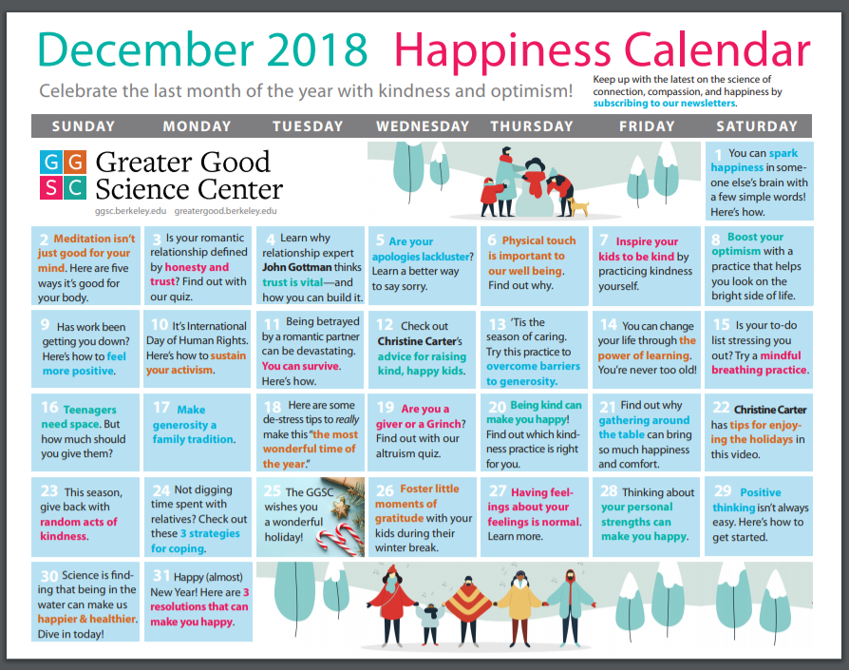

Slide 4
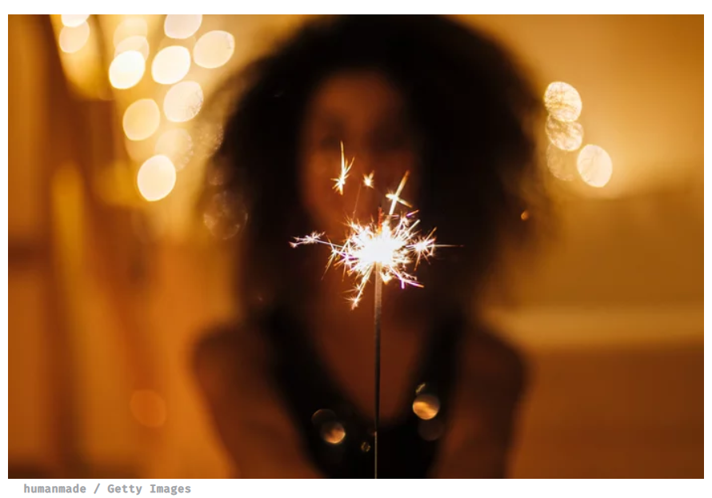
9 New Year, New Me Ideas Not Resolutions
https://hellogiggles.com/lifestyle/new-year-new-me-not-resolutions/

Slide 5

Afternoon Energizer

